Slide 2
Objectives
Explain variables and their purpose
State the syntax of variable declaration
Explain the rules and conventions for naming variables
Explain data types
Describe primitive and reference data types
Describe escape sequence
Describe format specifiers
Identify and explain different type of operators
Explain the concept of casting
Explain implicit and explicit conversion

Slide 3
Introduction
The core of any programming language is the way it stores and manipulates the data.
The Java programming language can work with different types of data, such as number, character, boolean, and so on.
To work with these types of data, Java programming language supports the concept of variables.
A variable is like a container in the memory that holds the data used by the Java program.
A variable is associated with a data type that defines the type of data that will be stored in the variable.
Java is a strongly-typed language which means that any variable or an object created from a class must belong to its type and should store the same type of data.
The compiler checks all expressions variables and parameters to ensure that they are compatible with their data types.

Slide 4
Variables 1-2
A variable is a location in the computer’s memory which stores the data that is used in a Java program.
Following figure depicts a variable that acts as a container and holds the data in it:
Variables
are used in a Java program to store data that changes during the execution of the program.
are the basic units of storage in a Java program.
can be declared to store values, such as names, addresses, and salary details.
must be declared before they can be used in the program.
A variable declaration begins with data type and is followed by variable name and a semicolon.

Slide 5
Variables 2-2
The data type can be a primitive data type or a class.
The syntax to declare a variable in a Java program is as follows:
Syntax
datatype variableName;
where,
datatype: Is a valid data type in Java.
variableName: Is a valid variable name.
Following code snippet demonstrates how to declare variables in a Java program:
. . .
int rollNumber;
char gender;
. . .
In the code, the statements declare an integer variable named rollNumber, and a character variable called gender.
These variables will hold the type of data specified for each of them.

Slide 6
Rules for Naming Variables 1-2
Variable names may consist of Unicode letters and digits, underscore (_), and dollar sign ($).
A variable’s name must begin with a letter, the dollar sign ($), or the underscore character (_).
The convention, however, is to always begin your variable names with a letter, not ‘$’ or ‘_’.
Variable names must not be a keyword or reserved word in Java.
Variable names in Java are case-sensitive.
For example, the variable names number and Number refer to two different variables.
If a variable name comprises a single word, the name should be in lowercase.
For example, velocity or ratio.
If the variable name consists of more than one word, the first letter of each subsequent word should be capitalized.
For example, employeeNumber and accountBalance.

Slide 7
Rules for Naming Variables 2-2
Following table shows some examples of valid and invalid Java variable names:
Variable Name | Valid/Invalid
rollNumber | Valid
a2x5_w7t3 | Valid
$yearly_salary | Valid
_2010_tax | Valid
$$_ | Valid
amount#Balance | Invalid and contains the illegal character #
double | Invalid and is a keyword
4short | Invalid and the first character is a digit

Slide 8
Assigning Value to a Variable 1-3
Values can be assigned to variables by using the assignment operator (=).
There are two ways to assign value to variables. These are as follows:
At the time of declaring a variable
Following code snippet demonstrates the initialization of variables at the time of declaration:
...
int rollNumber = 101;
char gender = ‘M’;
...
Assigning Value to a Variable 1-
In the code, variable rollNumber is an integer variable, so it has been initialized with a numeric value 101.
Similarly, variable gender is a character variable and is initialized with a character ‘M’.
The values assigned to the variables are called as literals.
Literals are constant values assigned to variables directly in the code without any computation.

Slide 9
Assigning Value to a Variable 2-3
After the variable declaration
Following code snippet demonstrates the initialization of variables after they are declared:
int rollNumber; // Variable is declared
. . .
rollNumber = 101; //variable is initialized
. . .
Here, the variable rollNumber is declared first and then, it has been initialized with the numeric literal 101.
Following code snippet shows the different ways for declaring and initializing variables in Java:
// Declares three integer variables x, y, and z
int x, y, z;
// Declares three integer variables, initializes a and c
int a = 5, b, c = 10;
// Declares a byte variable num and initializes its value to 20
byte num = 20;

Slide 10
Assigning Value to a Variable 3-3
// Declares the character variable c with value ‘c’
char c = ‘c’;
// Stores value 10 in num1 and num2
int num1 = num2 = 10; //
In the code, the declarations, int x, y, z; and int a=5, b, c=10; are examples of comma separated list of variables.
The declaration int num1 = num2 = 10; assigns same value to more than one variable at the time of declaration.

Slide 11
Different Types of Variables 1-3
Java programming language allows you to define different kind of variables that are categorized as follows:
Instance variables
The state of an object is represented as fields or attributes or instance variables in the class definition.
Each object created from a class will have its own copy of instance variables.
Following figure shows the instance variables declared in a class template:

Slide 12
Different Types of Variables 2-3
Instance variables
These are also known as class variables.
Only one copy of static variable is maintained in the memory that is shared by all the objects belonging to that class.
These fields are declared using the static keyword.
Following figure shows the static variables in a Java program:

Slide 13
Different Types of Variables 3-3
Local variables
The variables declared within the blocks or methods of a class are called local variables.
A method represents the behavior of an object.
The local variables are visible within those methods and are not accessible outside them.
A method stores it temporary state in local variables.
There is no special keyword available for declaring a local variable, hence, the position of declaration of the variable makes it local.

Slide 14
Scope and Lifetime of Variables 1-3
In Java, variables can be declared within a class, method, or within any block.
A scope determines the visibility of variables to other part of the program.
Languages
such as C/C++
Java
Local
Global
Class
Method
Class scope
The variables declared within the class can be instance variables or static variables.
The instance variables are owned by the objects of the class and their existence or scope depends upon the object creation.
Static variables are shared between the objects and exists for the lifetime of a class.

Slide 15
Scope and Lifetime of Variables 2-3
Method scope
The variables defined within the methods of a class are local variables.
The lifetime of these variables depends on the execution of methods.
This means memory is allocated for the variables when the method is invoked and destroyed when the method returns.
After the variables are destroyed, they are no longer in existence.
Methods parameters values passed to them during method invocation.
The parameter variables are also treated as local variables which means their existence is till the method execution is completed.

Slide 16
Scope and Lifetime of Variables 3-3
Following figure shows the scope and lifetime of variables x and y defined within the Java program:

Slide 17
Data Types
When you define a variable in Java, you must inform the compiler what kind of a variable it is.
That is, whether it will be expected to store an integer, a character, or some other kind of data.
This information tells the compiler how much space to allocate in the memory depending on the data type of a variable.
Thus, the data types determine the type of data that can be stored in variables and the operation that can be performed on them.
In Java, data types fall under two categories that are as follows:
Primitive data types
Reference data types

Slide 18
Primitive Data Types
The Java programming language provides eight primitive data types to store data in Java programs.
A primitive data type, also called built-in data type, stores a single value at a time, such as a number or a character.
The size of each data type will be same on all machines while executing a Java program.
The primitive data types are predefined in the Java language and are identified as reserved words.
Following figure shows the primitive data types that are broadly grouped into four groups:

Slide 19
Integer Types
The integer data types supported by Java are byte, short, int, and long.
These data type can store signed integer values.
Signed integers are those integers, which are capable of representing positive as well as negative numbers, such as -40.
Java does not provide support for unsigned integers.
Following table lists the details about the integer data types:
byte | short | int | long
A signed 8-bit type. | A signed 16-bit type. | Signed 32-bit type. | Signed 64-bit type.
Range: -128 to 127 | Range: -32,768 to 32,767 | Range: -2,147,483,648 to 2,147,483,647 | Range: 9,223,372,036,854,775,808 to 9,223,372,036,854,775,807
Useful when working with raw binary data. | Used to store smaller numbers, for example, employee number. | Used to store the total salary being paid to all the employees of the company. | Used to store very large values such as population of a country.
Keyword: byte | Keyword: short | Keyword: int | Keyword: long

Slide 20
Floating-point Types
The floating-point data types supported by Java are float and double.
These are also called real numbers, as they represent numbers with fractional precision.
For example, calculation of a square root or PI value is represented with a fractional part.
The brief description of the floating-point data types is given in the following table:
float | byte
A single precision value with 32-bit storage. | A double precision with 64-bit storage.
Useful when a number needs a fractional component, but with less precision. | Useful when accuracy is required to be maintained while performing calculations.
Keyword: float | Keyword: double
For example, float squRoot, cubeRoot; | For example, double bigDecimal;

Slide 21
Character and Boolean Types 1-4
char data type belongs to this group and represents symbols in a character set like letters and numbers.
char data type stores 16-bit Unicode character and its value ranges from 0 (‘\u0000’) to 65,535 (‘\uffff’).
Unicode is a 16-bit character set, which contains all the characters commonly used in information processing.
It is an attempt to consolidate the alphabets of the world’s various languages into a single and international character set.
boolean data type represents true or false values.
This data type is used to track true/false conditions.
Its size is not defined precisely.
Apart from primitive data types, Java programming language also supports strings.
A string is a sequence of characters.
Java does not provide any primitive data type for storing strings, instead provides a class String to create string variables.
The String class is defined within the java.lang package in Java SE API.

Slide 22
Character and Boolean Types 2-4
Following code snippet demonstrates the use of String class as primitive data type:
. . .
String str = “A String Data”;
. . .
The statement, String str creates an String object and is not of a primitive data type.
When you enclose a string value within double quotes, the Java runtime environment automatically creates an object of String type.
Also, once the String variable is created with a value ‘A String Data’, it will remain constant and you cannot change the value of the variable within the program.
However, initializing string variable with new value creates a new String object.
This behavior of strings makes them as immutable objects.

Slide 23
Character and Boolean Types 3-4
Following code snippet demonstrates the use of different data types in Java:
public class EmployeeData {
/**
* @param args the command line arguments
*/
public static void main(String[] args) {
// Declares a variable of type integer
int empNumber;
//Declares a variable of type decimal
float salary;
// Declare and initialize a decimal variable
double shareBalance = 456790.897;
// Declare a variable of type character
char gender = ‘M’;
// Declare and initialize a variable of type boolean
boolean ownVehicle = false;
// Variables, empNumber and salary are initialized
empNumber = 101;
salary = 6789.50f;

Slide 24
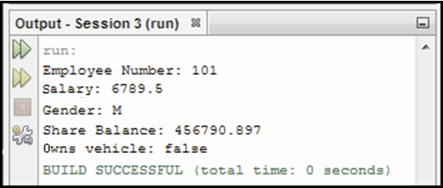
Character and Boolean Types 4-4
// Prints the value of the variables on the console
System.out.println(“Employee Number: “ + empNumber);
System.out.println(“Salary: “ + salary);
System.out.println(“Gender: “ + gender);
System.out.println(“Share Balance: “ + shareBalance);
System.out.println(“Owns vehicle: “ + ownVehicle);
}
}
Here, a float value needs to have the letter f appended at its end.
Otherwise, by default, all the decimal values are treated as double in Java.
The output of the code is shown in the following figure:

Slide 25
Reference Data Types
In Java, objects and arrays are referred to as reference variables.
Reference data type is an address of an object or an array created in memory.
Following figure shows the reference data types supported in Java:
Following table lists and describes the three reference data types:
Data Type | Description
Array | It is a collection of several items of the same data type. For example, names of students in a class can be stored in an array.
Class | It is encapsulation of instance variables and instance methods.
Interface | It is a type of class in Java used to implement inheritance.

Slide 26
Literals 1-4
A literal represents a fixed value assigned to a variable.
It is represented directly in the code and does not require computation.
Following figure shows some literals for primitive data types:
A literal is used wherever a value of its type is allowed.
However, there are several different types of literals as follows:
Integer Literals
Integer literals are used to represent an int value, which in Java is a 32-bit integer value.
Integers literals can be expressed as:
Decimal values have a base of 10 and consist of numbers from 0 through 9. For example, int decNum = 56;.
Hexadecimal values have a base of 16 and consist of numbers 0 through 9 and letters A through F. For example, int hexNum = 0X1c;.

Slide 27
Literals 2-4
Binary values have a base of 2 and consist of numbers 0 and 1. Java SE 7 supports binary literals. For example, int binNum = 0b0010;.
An integer literal can also be assigned to other integer types, such as byte or long.
When a literal value is assigned to a byte or short variable, no error is generated, if the literal value is within the range of the target type.
Integer numbers can be represented with an optional uppercase character (‘L’) or lowercase character (‘l’) at the end.
This will inform the computer to treat that number as a long (64-bit) integer.
Floating-point Literals
Floating-point literals represent decimal values with a fractional component.
Floating-point literals have several parts.
Whole number component, for example 0, 1, 2,....., 9.
Decimal point, for example 4.90, 3.141, and so on.

Slide 28
Literals 3-4
Exponent is indicated by an E or e followed by a decimal number, which can be positive or negative. For example, e+208, 7.436E6, 23763E-05, and so on.
Type suffix D, d, F, or f.
Floating-point literals in Java default to double precision.
A float literal is represented by F or f appended to the value, and a double literal is represented by D or d.
Boolean Literals
Boolean literals are simple and have only two logical values - true and false.
These values do not convert into any numerical representation.
A true boolean literal in Java is not equal to one, nor does the false literal equals to zero.
They can only be assigned to boolean variables or used in expressions with boolean operators.

Slide 29
Literals 4-4
Character Literals
Character literals are enclosed in single quotes.
All the visible ASCII characters can be directly enclosed within quotes, such as ‘g’, ‘$’, and ‘z’.
Single characters that cannot be enclosed within single quotes are used with escape sequence.
Null Literals
When an object is created, a certain amount of memory is allocated for that object.
The starting address of the allocated memory is stored in an object variable, that is, a reference variable.
However, at times, it is not desirable for the reference variable to refer that object.
In such a case, the reference variable is assigned the literal value null. For example, Car toyota = null;.
String Literals
String literals consist of sequence of characters enclosed in double quotes. For example, “Welcome to Java”, “Hello\nWorld”.

Slide 30
Underscore Character in Numeric Literals 1-2
Java SE 7 allows you to add underscore characters (_) between the digits of a numeric literal.
The underscore character can be used only between the digits.
In integral literals, underscore characters can be provided for telephone numbers, identification numbers, or part numbers, and so on.
Similarly, for floating-point literals, underscores are used between large decimal values.
Restrictions for using underscores in numeric literals are as follows:
A number cannot begin or end with an underscore.
In the floating-point literal, underscore cannot be placed adjacent to a decimal point.
Underscore cannot be placed before a suffix, L or F.
Underscore cannot be placed before or after the binary or hexadecimal identifiers, such as b or x.

Slide 31
Underscore Character in Numeric Literals 2-2
Following table shows the list of valid and invalid placement of underscore character:
Numeric Literal | Valid/Invalid
1234_9876_5012_5454L | Valid
_8976 | Invalid, as underscore placed at the beginning
3.14_15F | Valid
0b11010000_11110000_00001111 | Valid
3_.14_15F | Invalid, as underscore is adjacent to a decimal point
0x_78 | Invalid, an underscore is placed after the hexadecimal

Slide 32
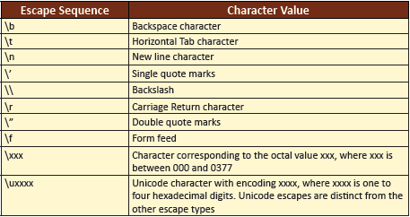
Escape Sequences 1-3
An escape sequence is a special sequence of characters that is used to represent characters, which cannot be entered directly into a string.
For example, to include tab spaces or a new line character in a line or to include characters which otherwise have a different notation in a Java program (\ or “), escape sequences are used.
An escape sequence begins with a backslash character (\), which indicates that the character (s) that follows should be treated in a special way.
The output displayed by Java can be formatted with the help of escape sequence characters.
Following table lists escape sequence characters in Java:

Slide 33
Escape Sequences 2-3
Following code snippet demonstrates the use of escape sequence characters:
public class EscapeSequence {
/*
* @param args the command line arguments
*/
public static void main(String[] args) {
// Uses tab and new line escape sequences
System.out.println(“Java \t Programming \n Language”);
// Prints Tom “Dick” Harry string
System.out.println(“Tom \”Dick\” Harry”);
}
}
The output of the code is shown in the following figure:

Slide 34
Escape Sequences 3-3
To represent a Unicode character, \u escape sequence can be used in a Java program.
A Unicode character can be represented using hexadecimal or octal sequences.
Following code snippet demonstrates the Unicode characters in a Java program:
public class UnicodeSequence {
/**
* @param args the command line arguments
*/
public static void main(String[] args) {
// Prints ‘Hello’ using hexadecimal escape sequence characters
System.out.println(“\u0048\u0065\u006C\u006C\u006F” + “!\n”);
// Prints ‘Blake’ using octal escape sequence character for ‘a’
System.out.println(“Bl\141ke\”2007\” “);
}
}
The output of the code is shown in the following figure:

Slide 35
Constants and Enumerations 1-5
Constants in Java are fixed values assigned to identifiers that are not modified throughout the execution of the code.
In Java, the declaration of constant variables is prefixed with the final keyword.
The syntax to initialize a constant variable is as follows:
Syntax
final data-type variable-name = value;
where,
final: Is a keyword and denotes that the variable is declared as a constant.
Following code snippet demonstrates the code that declares the constant variables:
public class AreaOfCircle {
/**
* @param args the command line arguments
*/
public static void main(String[] args) {
// Declares constant variable
final double PI = 3.14159;
double radius = 5.87;
double area;

Slide 36
Constants and Enumerations 2-5
// Calculates the value for the area variable
area = PI * radius * radius;
System.out.println(“Area of the circle is: “ + area);
}
}
In the code, a constant variable PI is assigned the value 3.14159, which is a fixed value.
The output of the code is shown in the following figure:

Slide 37
Constants and Enumerations 3-5
The enumeration is created using the enum keyword.
This means it can contain instance variables, methods, and constructors.
Unlike C++, where enumeration was a list of named integer constants, in Java, enumeration is a class type.
An enumeration is defined as a list that contains constants.
Java SE 5.0 introduced enumerations.
The syntax for declaring a method is as follows:
Syntax
enum enum-name {
constant1, constant2, . . . , constantN
}

Slide 38
Constants and Enumerations 4-5
Though, enumeration is a class in Java, you do not use new operator to instantiate it.
Instead, declare a variable of type enumeration to use it in the Java program.
This is similar to using primitive data types.
The enumeration is mostly used with decision-making constructs, such as switch-case statement.
Following code snippet demonstrates the declaration of enumeration in a Java program:
public class EnumDirection {
/**
* Declares an enumeration
*/
enum Direction {
East, West, North, South
}
/**
* @param args the command line arguments
*/
public static void main(String[] args) {

Slide 39
Constants and Enumerations 5-5
// Declares a variable of type Direction
Direction direction;
// Instantiate the enum Direction
direction = Direction.East;
// Prints the value of enum
System.out.println(“Value: “ + direction);
}
}
The output of the code is shown in the following figure:

Slide 40
Formatted Output and Input
Whenever an output is to be displayed on the screen, it needs to be formatted.
Formatting can be done using three ways that are as follows:
print() and println()
printf()
format()
These methods behave in a similar manner.
The format() method uses the java.util.Formatter class to do the formatting work.

Slide 41
‘print()’ and ‘println()’ Methods 1-2
These methods convert all the data to strings and display it as a single value.
The methods uses the appropriate toString() method for conversion of the values.
These methods can also be used to print mixture combination of strings and numeric values as strings on the standard output.
Following code snippet demonstrates the use of print() and println() methods:
public class DisplaySum {
/**
* @param args the command line arguments
*/
public static void main(String[] args) {
“ + sum + “.”); int num1 = 5;
int num2 = 10;
int sum = num1 + num2;
System.out.print(“The sum of “);
System.out.print(num1);
System.out.print(“ and “);
System.out.print(num2);
System.out.print(“ is “);
System.out.print(sum);

Slide 42
‘print()’ and ‘println()’ Methods 2-2
System.out.println(“.”);
int num3 = 2;
sum = num1 + num2 + num3;
System.out.println(“The sum of “ + num1 + “, “ + num2 + “ and “ +
num3 + “ is
}
}
The sum variable is formatted twice.
In the first case, the print() method is used for each instruction which prints the result on the same line.
In the second case, the println() method is used to convert each data type to string and concatenate them to display as a single result.
The output of the code is shown in the following figure:

Slide 43
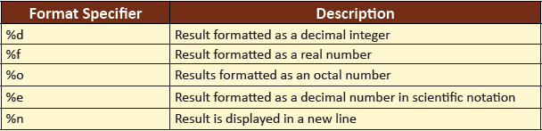
‘printf()’ Method 1-2
The printf() method introduced in J2SE 5.0 can be used to format the numerical output to the console.
Following table lists some of the format specifiers in Java:
Following code snippet demonstrates the use of printf() methods to format the output:
public class FormatSpecifier {
/**
* @param args the command line arguments
*/
public static void main(String[] args) {
int i = 55 / 22;
// Decimal integer
System.out.printf(“55/22 = %d %n”, i);

Slide 44
‘printf()’ Method 2-2
// Pad with zeros
double q = 1.0 / 2.0;
System.out.printf(“1.0/2.0 = %09.3f %n”, q);
// Scientific notation
q = 5000.0 / 3.0;
System.out.printf(“5000/3.0 = %7.2e %n”, q);
// Negative infinity
q = -10.0 / 0.0;
System.out.printf(“-10.0/0.0 = %7.2e %n”, q);
// Multiple arguments, PI value, E–base of natural logarithm
System.out.printf(“pi = %5.3f, e = %5.4f %n”, Math.PI, Math.E);
}
}
The output of the code is shown in the following figure:

Slide 45
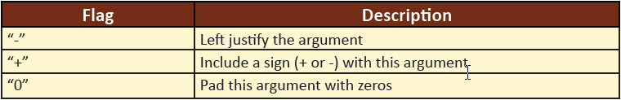
‘format()’ Method 1-3
This method formats multiple arguments based on a format string.
The format string consists of the normal string literal information associated with format specifiers and an argument list.
The syntax of a format specifier is as follows:
Syntax
%[arg_index$] [flags] [width] [.precision] conversion character
where,
arg_index: Is an integer followed by a $ symbol. The integer indicates that the argument should be printed in the mentioned position.
flags: Is a set of characters that format the output result. There are different flags available in Java.
Following table lists some of the flags available in Java:

Slide 46

‘format()’ Method 2-3
width: Indicates the minimum number of characters to be printed and cannot be negative.
precision: Indicates the number of digits to be printed after a decimal point. Used with floating-point numbers.
conversion character: Specifies the type of argument to be formatted. For example, b for boolean, c for char, d for integer, f for floating-point, and s for string.
The values within ‘[]’ are optional.
The only required elements of format specifier are the % and a conversion character.
Following code snippet demonstrates the format() method:
public class VariableScope {
/**
* @param args the command line arguments
*/
public static void main(String[] args) {

Slide 47
‘format()’ Method 3-3
int num = 2;
double result = num * num;
System.out.format(“The square root of %d is %f.%n”, num, result);
}
}
The output of the code is shown in the following figure:

Slide 48
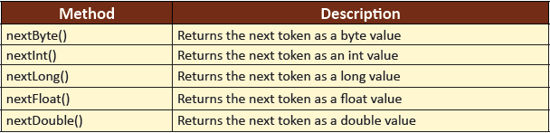
Formatted Input 1-3
The Scanner class allows the user to read or accept values of various data types from the keyboard.
It breaks the input into tokens and translates individual tokens depending on their data type.
To use the Scanner class, pass the InputStream object to the constructor as follows:
Scanner input = new Scanner(System.in);
Here, input is an object of Scanner class and System.in is an input stream object.
Following table lists the different methods of the Scanner class that can be used to accept numerical values from the user:

Slide 49
Formatted Input 2-3
Following code snippet demonstrates the Scanner class methods and how they can be used to accept values from the user:
public class FormattedInput {
/**
* @param args the command line arguments
*/
public static void main(String[] args) {
// Creates an object and passes the inputstream object
Scanner s = new Scanner(System.in);
System.out.println(“Enter a number:”);
// Accepts integer value from the user
int intValue = s.nextInt();
System.out.println(“Enter a decimal number:”);
// Accepts integer value from the user
float floatValue = s.nextFloat();
System.out.println(“Enter a String value”);
// Accepts String value from the user
String strValue = s.next();

Slide 50
Formatted Input 3-3
System.out.println(“Values entered are: “);
System.out.println(intValue + “ “ + floatValue + “ “ + strValue);
}
}
The output of the code is shown in the following figure:

Slide 51
Operators
Operators are set of symbols used to indicate the kind of operation to be performed on data.
Consider the expression: Z = X + Y;
Here,
+
is called the Operator and the operation performed is addition.
X and Y
the two variables X and Y, on which addition is performed, are called as Operands.
Z = X + Y
a combination of both the operator and the operands, is known as an Expression.
Java provides several categories of operators and they are as follows:
Assignment Operator
Arithmetic Operator
Unary Operator
Conditional Operator
Logical Operator
Assignment Operator
Bitwise Operator

Slide 52
Assignment Operators 1-2
In other words, it allows you to create a chain of assignments.
Assigning values to more than one variable can be done at a time.
This operator is used to assign the value on its right to the operand on its left.
The basic assignment operator is a single equal to sign, ‘=’.
Consider the following statements:
int balance = 3456;
char gender = ‘M’;
The value 3456 and ‘M’ are assigned to the variables, balance and gender.

Slide 53
Assignment Operators 2-2
In addition to the basic assignment operator, there are combined operators that allow you to use a value in an expression, and then, set its value to the result of that expression.
X = 3;
X += 5;
The second statement stores the value 8, the meaning of the statement is that X = X + 5.
Following code snippet demonstrates the use of assignment operators:
...
x = 10; // Assigns the value 10 to variable x
x += 5; // Increments the value of x by 5
x -= 5; // Decrements the value of x by 5
x *= 5; // Multiplies the value of x by 5
x /= 2; // Divides the value of x by 2
x %= 2; // Divides the value of x by 2 and the remainder is returned

Slide 54
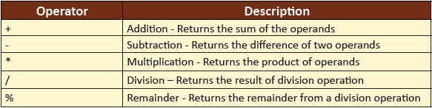
Arithmetic Operators
Arithmetic operators manipulate numeric data and perform common arithmetic operations on the data.
Operands of the arithmetic operators must be of numeric type.
Boolean operands cannot be used, but character operands are allowed.
The operators mentioned here are binary in nature that is, these operate on two operands, such as X+Y. Here, + is a binary operator operating on X and Y.
Following table lists the arithmetic operators:
Following code snippet demonstrates the use of arithmetic operators:
...
x = 2 + 3; // Returns 5
y = 8 – 5; // Returns 3
x = 5 * 2; // Returns 10
x = 5/2; // Returns 2
y = 10 % 3; // Returns 1
...

Slide 55
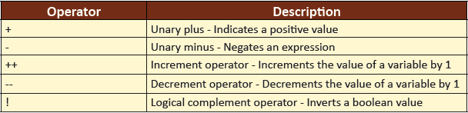
Unary Operator
Unary operators require only one operand.
They increment/decrement the value of a variable by 1, negate an expression, or invert the value of a boolean variable. Following table lists the unary operators:
The prefix version (++variable) will increment the value before evaluating.
The postfix version (variable++) will first evaluate and then, increment the original value.
Following code snippet demonstrates the use of unary operators:
...
int i = 5;
int j = i++; // i=6, j=5
int k = ++i; //i=6,k=6
i = - i ; //now i is -6
boolean result = false; //result is false
result = !result; //now result is true
…

Slide 56
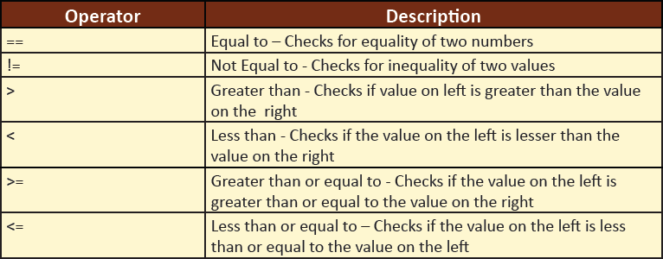
Conditional Operators 1-2
The conditional operators test the relationship between two operands.
An expression involving conditional operators always evaluates to a boolean value (that is, either true or false).
Following table lists the various conditional operators:
Following code snippet demonstrates the use of conditional operators:
public class TestConditionalOperators {
/**
* @param args the command line arguments
*/
public static void main(String[] args) {
int value1 = 10;
int value2 = 20;

Slide 57
Conditional Operators 2-2
// Use of conditional operators
System.out.print(“value1 == value2: “);
System.out.println(value1 == value2);
System.out.print(“value1 != value2: “);
System.out.println(value1 != value2);
System.out.print(“value1 > value 2: “);
System.out.println(value1 > value2);
System.out.print(“value1 < value2: “);
System.out.println(value1 < value2);
System.out.print(“value1 <= value2: “);
System.out.println(value1 <= value2);
}
}
The output of the code is shown in the following figure:

Slide 58
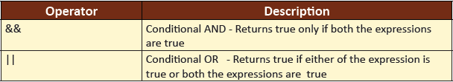
Logical Operators 1-2
Logical operators (&& and ||) work on two boolean expressions.
These operators exhibit short-circuit behavior, which means that the second operand is evaluated only if required.
Following table lists the two logical operators:
Following code snippet demonstrates the use of logical operators:
public class TestLogicalOperators {
/**
* @param args the command line arguments
*/
public static void main(String[] args) {
int first = 10;
int second = 20;
// Use of logical operator
System.out.println((first == 30) && (second == 20));

Slide 59
Logical Operators 2-2
System.out.println((first == 30) || (second == 20));
}
}
The output of the code is shown in the following figure:

Slide 60
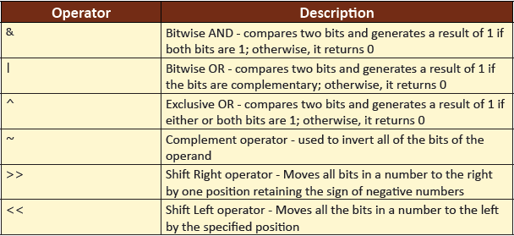
Bitwise Operators 1-2
Bitwise operators work on binary representations of data.
These operators are used to change individual bits in an operand.
Following table lists the various bitwise operators:
Following code snippet demonstrates the use of bitwise operators:
public class TestBitwiseOperators {
/**
* @param args the command line arguments
*/
public static void main(String[] args) {
int x = 23;
int y = 12;
//23 = 10111 , 12 = 01100

Slide 61
Bitwise Operators 2-2
System.out.print(“x & y: “);
System.out.println(x & y); // Returns 4 , i.e, 4 = 00100
System.out.print(“x | y: “);
System.out.println(x | y); // Returns 31, i.e 31 = 11111
System.out.print(“x ^ y: “);
System.out.println(x ^ y); // Returns 27, i.e 31 = 11011
int a = 43;
int b = 1;
System.out.print(“a >> b: “);
System.out.println(a >> b); // returns 21 , i.e, 21 = 0010101
System.out.print(“a << b: “);
System.out.println(a << b); //returns 86 , i.e, 86 = 1010110
}
}
The output of the code is shown in the following figure:

Slide 62
Ternary Operator 1-2
The ternary operator (?:) is a shorthand operator for an if-else statement.
It makes your code compact and more readable.
The syntax to use the ternary operator is as follows:
Syntax
expression1 ? expression2 : expression3
where,
expression1: Represents an expression that evaluates to a boolean value of true or false.
expression2: Is executed if expression1 evaluates to true.
expression3: Is executed if expression1 evaluates to false.
Following code snippet demonstrates the use of ternary operator:
public class VariableScope {
/**
* @param args the command line arguments
*/
public static void main(String[] args) {
int value1 = 10;

Slide 63
Ternary Operator 2-2
int value2 = 20;
int result;
boolean someCondition = true;
result = someCondition ? value1 : value2;
System.out.println(result);
}
}
As someCondition variable evaluates to true, the value of value1 variable is assigned to the result variable.
Thus, the program prints 10 on the console.

Slide 64
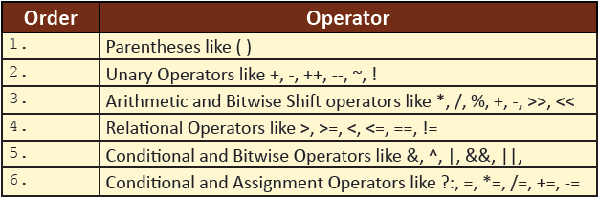
Operator Precedence 1-2
Expressions that are written generally consist of several operators.
The rules of precedence decide the order in which each operator is evaluated in any given expression.
Following table lists the order of precedence of operators from highest to lowest in which operators are evaluated in Java:
Parentheses are used to change the order in which an expression is evaluated.
Any part of an expression enclosed in parentheses is evaluated first.
For example, consider the following expression:
2*3+4/2 > 3 && 3<5 || 10<9

Slide 65
Operator Precedence 2-2
The evaluation of the expression based on its operators precedence is as follows:
1
(2*3+4/2) > 3 && 3<5 || 10<9
2
((2*3)+(4/2)) > 3 && 3<5 || 10<9
3
(6+2) >3 && 3<5 || 10<9
4
5
6
7
First the arithmetic operators are evaluated.
Division and Multiplication are evaluated before addition and subtraction.
(8>3) && [3<5] || [10<9]
These are therefore evaluated from left to right.
The last to be evaluated are the logical operators. && takes precedence over ||.
True || False
True
(True && True) || False
Next to be evaluated are the relational operators all of which have the same precedence.

Slide 66
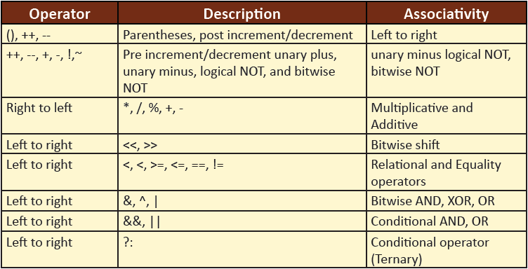
Operator Associativity 1-2
When two operators with the same precedence appear in an expression, the expression is evaluated, according to its associativity.
For example, in Java the - operator has left-associativity and x - y - z is interpreted as (x - y) - z, and = has right-associativity and x = y = z is interpreted as x = (y = z).
Following table shows the Java operators and their associativity:

Slide 67
Operator Associativity 2-2
Consider the following expression:
2+10+4-5*(7-1)
1
The ‘*’ has higher precedence than any other operator in the equation.
2
Next, ‘*’ is the operator with the highest precedence.
3
As ‘+’ and ‘-‘ have the same precedence, the left associativity works out.
4
Finally, the expression is evaluated from left to right.
2+10+4-5*6
However, as 7-1 is enclosed in parenthesis, it is evaluated first.
2+10+4-30
12+4-30
6 – 30
The result is -14.
Since there are no more parentheses, it is evaluated according to the rules.

Slide 68
Type Casting
Type conversion or typecasting refers to changing an entity of one data type into another.
For instance, values from a more limited set, such as integers, can be stored in a more compact format.
There are two types of conversion:
implicit
The term for implicit type conversion is coercion.
explicit
The most common form of explicit type conversion is known as casting.
Explicit type conversion can also be achieved with separately defined conversion routines such as an overloaded object constructor.

Slide 69
Implicit Type Casting 1-3
When a data of a particular type is assigned to a variable of another type, then automatic type conversion takes place.
It is also referred to as implicit type casting, provided it meets the conditions specified:
The two types should be compatible
The destination type should be larger than the source
Following figure shows the implicit type casting:

Slide 70
Implicit Type Casting 2-3
The primitive numeric data types that can be implicitly cast are as follows:
long(64 bits) to float, double
int (32 bits) to long, float, double
short(16 bits) to int, long, float, double
byte (8 bits) to short, int, long, float, double
This is also known as the type promotion rule.
The type promotion rules are listed as follows:
If one operand is double then, the whole expression is promoted to double.
If one operand is float then, the whole expression is promoted to float.
If one operand is long, the whole expression is promoted to long.
All byte and short values are promoted to int type.

Slide 71
Implicit Type Casting 3-3
Following code snippet demonstrates implicit type conversion:
...
double dbl = 10;
long lng = 100;
int in = 10;
dbl = in; // assigns the integer value to double variable
lng = in; // assigns the integer value to long variable

Slide 72
Explicit Casting 1-2
A data type with lower precision, such as short, can be converted to a type of higher precision, such as int, without using explicit casting.
However, to convert a higher precision data type to a lower precision data type, such as float to int data type, an explicit cast is required.
The syntax for explicit casting is as follows:
Syntax
(target data type) value;
Following figure shows the explicit type casting of data types:

Slide 73
Explicit Casting 2-2
Following code snippet adds a float value to an int and stores the result as an integer:
...
float a = 21.3476f;
int b = (int) a + 5;
...
The float value in a is converted into an integer value 21.
It is then, added to 5, and the resulting value, 26, is stored in b.
This type of conversion is known as truncation.
The fractional component is lost when a floating-point is assigned to an integer type, resulting in the loss of precision.

Slide 74
Summary
Variables store values required in the program and should be declared before they are used. In Java, variables can be declared within a class, method, or within any block.
Data types determine the type of values that can be stored in a variable and the operations that can be performed on them. Data types in Java are divided mainly into primitive types and reference types.
A literal signifies a value assigned to a variable in the Java program. Java SE 7 supports the use of the underscore characters (_) between the digits of a numeric literal.
The output of the Java program can be formatted using three ways: print() and println(), printf(), format(). Similarly, the Scanner class allows the user to read or accept values of various data types from the keyboard.
Operators are symbols that help to manipulate or perform some sort of function on data.
Parentheses are used to change the order in which an expression is evaluated.
The type casting feature helps in converting a certain data type to another data type. The type casting can be automatic or manual and should follow the rules for promotion.

